Slide 1
Section 1.2: Finding Euler Circuits
Math for Liberal Studies

Slide 2
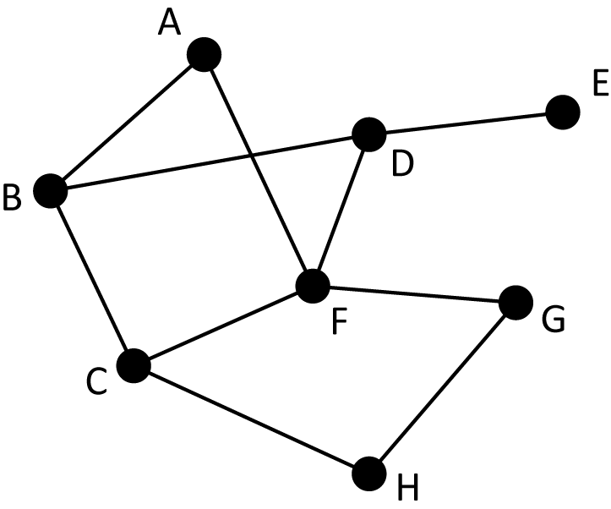
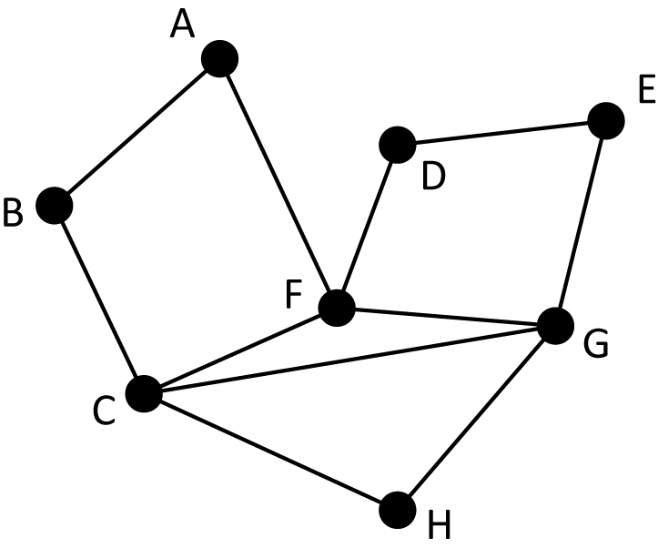
When does a graph have an Euler circuit?
This graph does not have an Euler circuit.
This graph does have an Euler circuit.

Slide 3
When does a graph have an Euler circuit?
How could I convince you that this graph has an Euler circuit?
I can show it to you!
This graph does have an Euler circuit.

Slide 4
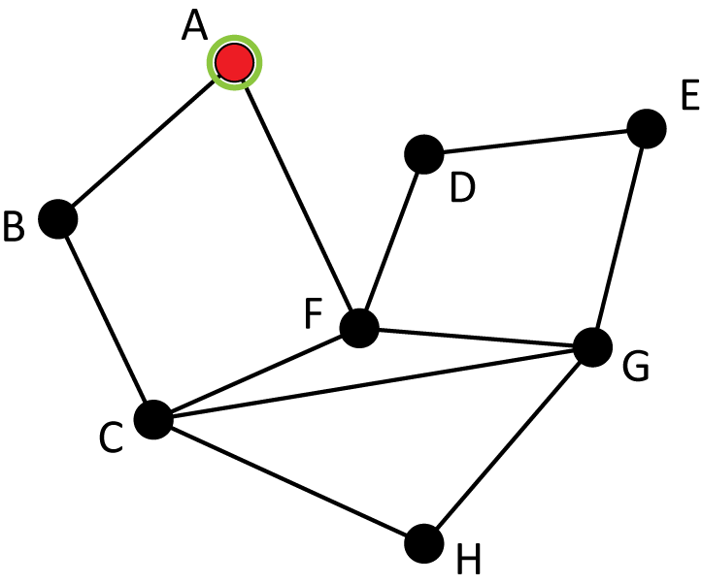
Finding the Euler Circuit

Slide 5
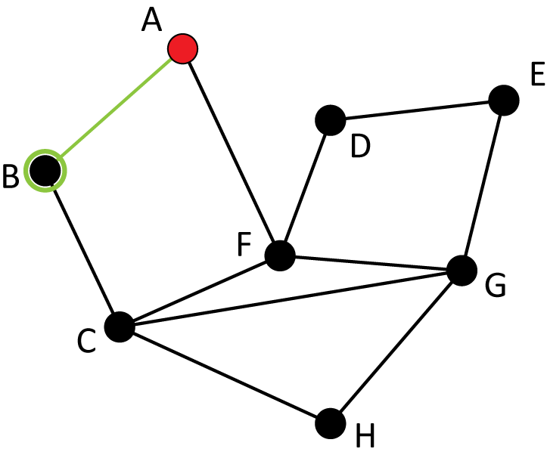
Finding the Euler Circuit

Slide 6
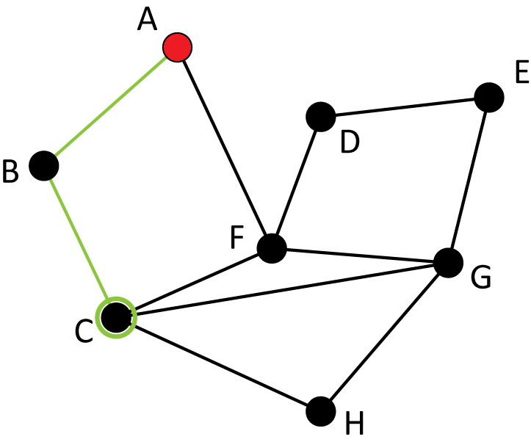
Finding the Euler Circuit

Slide 7
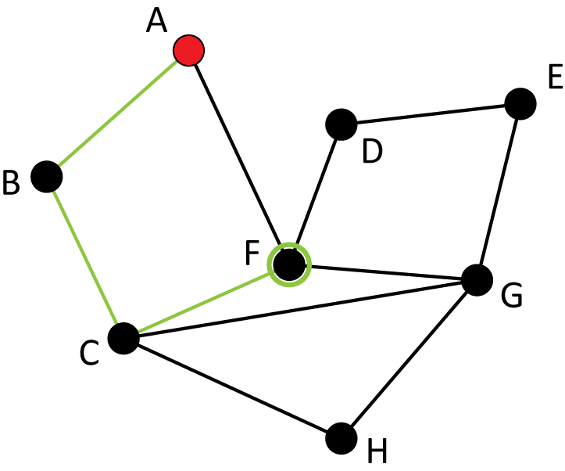
Finding the Euler Circuit

Slide 8
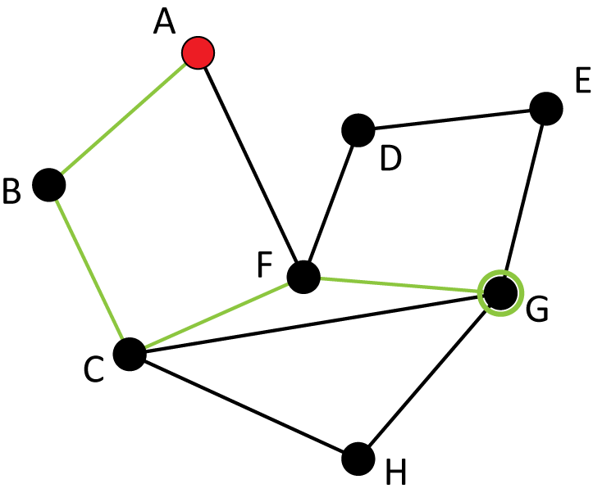
Finding the Euler Circuit

Slide 9
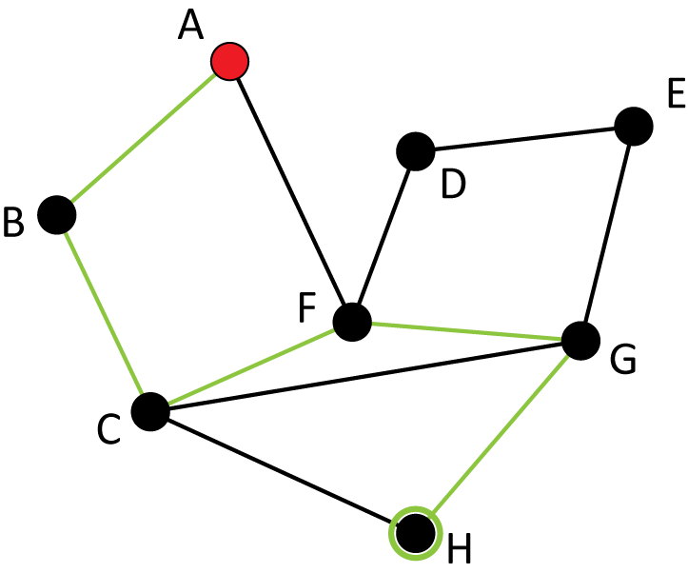
Finding the Euler Circuit

Slide 10
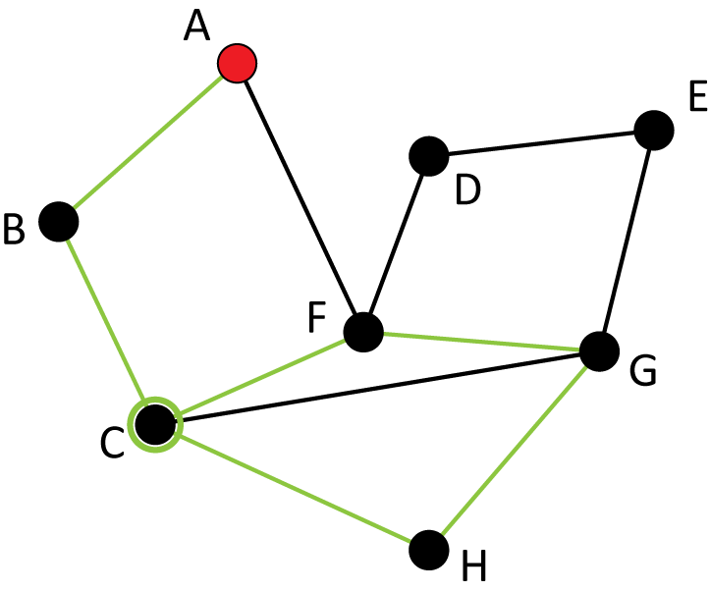
Finding the Euler Circuit

Slide 11
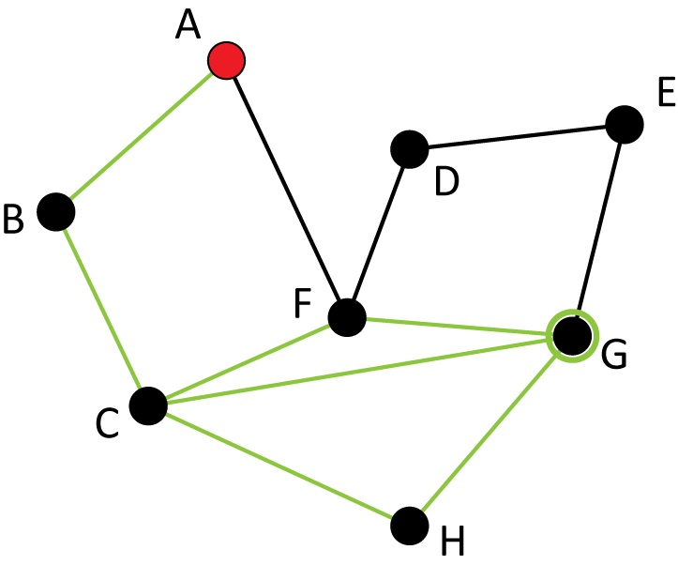
Finding the Euler Circuit

Slide 12
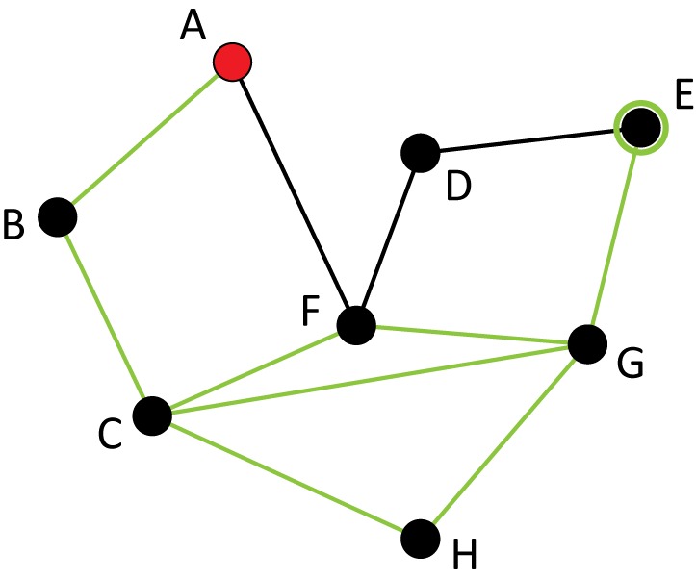
Finding the Euler Circuit

Slide 13
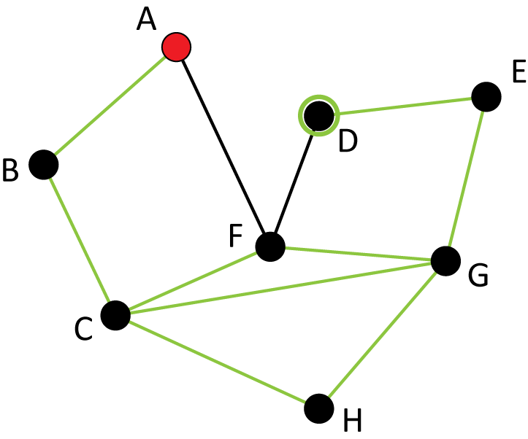
Finding the Euler Circuit

Slide 14
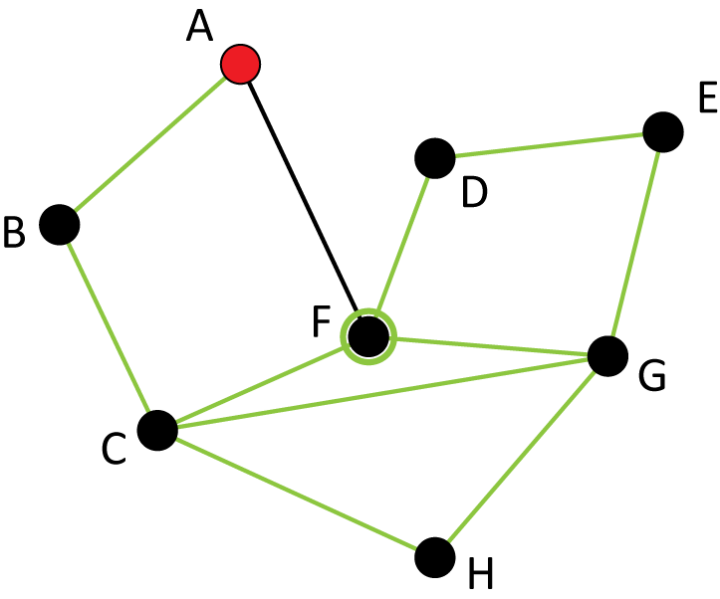
Finding the Euler Circuit

Slide 15
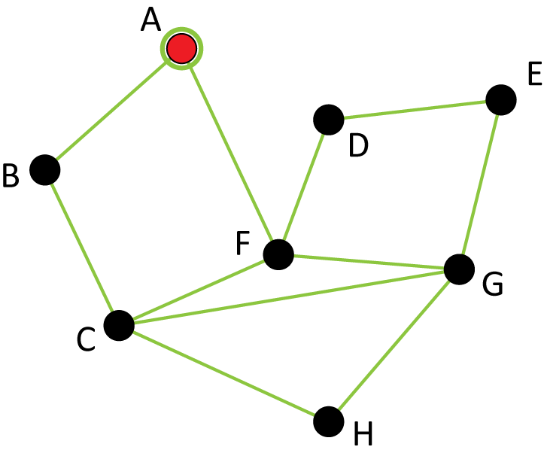
Finding the Euler Circuit

Slide 16
There are lots of Euler circuits…
That was just one of the many Euler circuits this graph has
Take a moment and try to find one on your own
You don’t have to start at A!

Slide 17
Why does a graph have an Euler circuit (or not)?
Why does this graph not have an Euler circuit?
Why does this graph have an Euler circuit?

Slide 18
Degree
The degree of a vertex is the number of edges that meet at that vertex

Slide 19
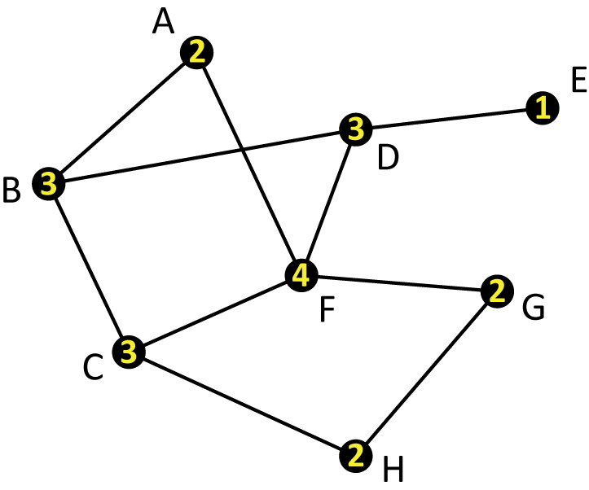
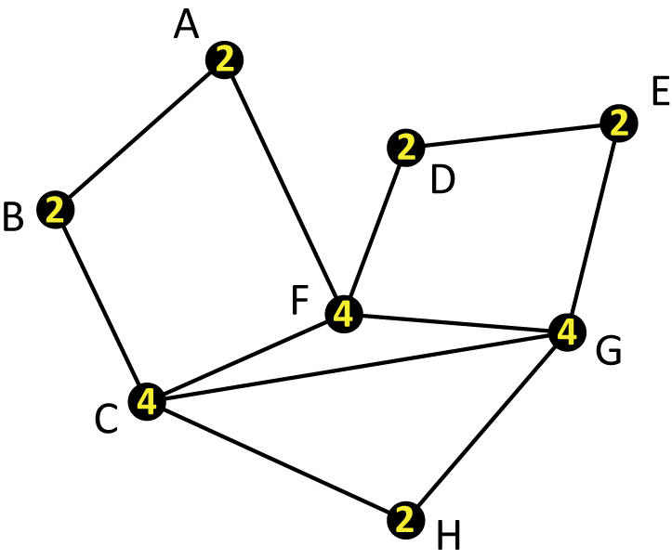
Degree
The degree of a vertex is the number of edges that meet at that vertex

Slide 20
Degree
The degree of a vertex is the number of edges that meet at that vertex
For example, in this graph, the degree of C is 4 because there are four edges (to B, to F, to G, and to H) that meet there

Slide 21
Fact About Degrees
Add up all the degrees in this graph
2+3+3+3+1+4+2+2 = 20
We have counted each edge twice

Slide 22
Fact About Degrees
We counted this edge when we added the degree of B, and we counted it again when we counted the degree of C

Slide 23
Fact About Degrees
The sum of all the degrees in a graph equals two times the total number of edges.

Slide 24
What does degree have to do with Euler circuits?
You might be able to tell right away that this graph can’t possibly have an Euler circuit
Why not?

Slide 25
What does degree have to do with Euler circuits?
If a graph has a vertex with degree 1, the graph cannot have an Euler circuit
If we start at E, we will never be able to return to E without retracing
If we don’t start at E, we will never be able to go there, since when we leave we will have to retrace

Slide 26
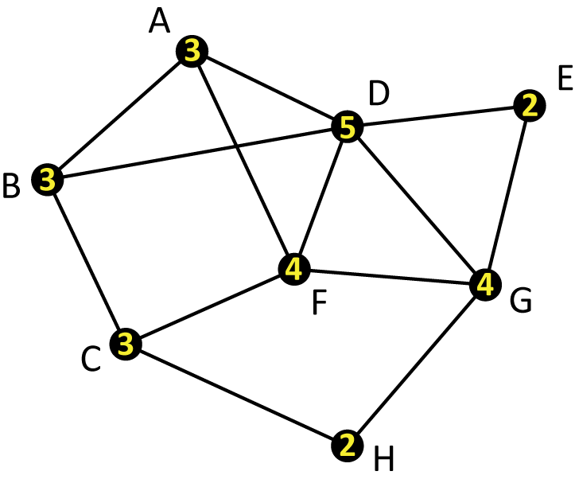
What does degree have to do with Euler circuits?
The problem isn’t just degree 1
This graph also doesn’t have an Euler circuit
The problem is that some of the degrees are odd numbers

Slide 27
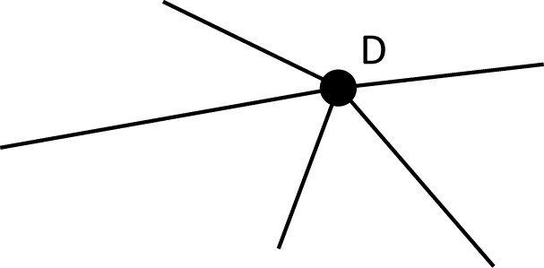
What does degree have to do with Euler circuits?
Let’s focus on vertex D, which has degree 5
Suppose we start elsewhere in the graph

Slide 28
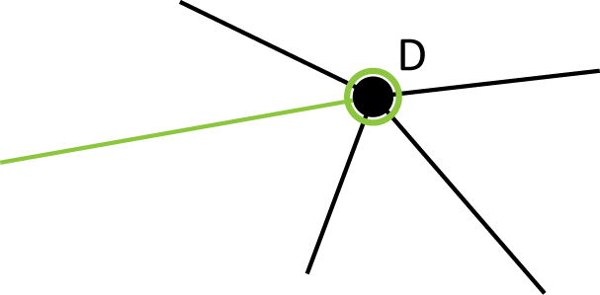
What does degree have to do with Euler circuits?
Since we want to cover all edges, we’ll have to visit D eventually

Slide 29
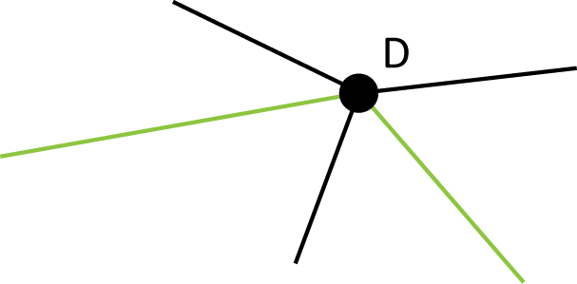
What does degree have to do with Euler circuits?
We have several unused edges, so we need to follow one of them and leave D

Slide 30
What does degree have to do with Euler circuits?
In fact, every time we visit a vertex, we will “use up” two of the edges that meet at that vertex

Slide 31
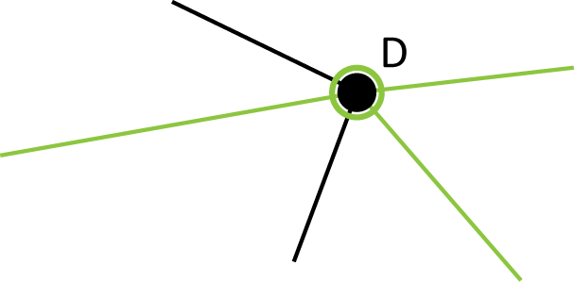
What does degree have to do with Euler circuits?
We have unused edges, so we need to visit D again at some point…

Slide 32
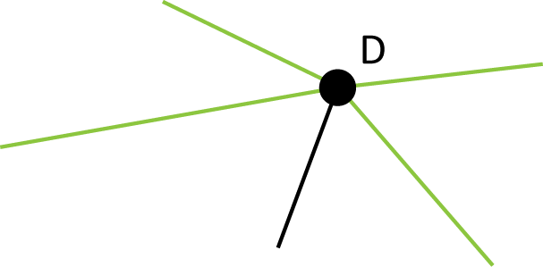
What does degree have to do with Euler circuits?
…and then leave again…

Slide 33
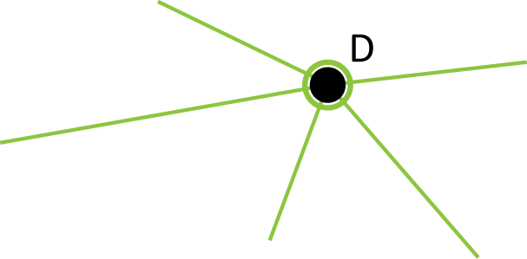
What does degree have to do with Euler circuits?
…and then come back again.
But now we’re stuck, since we can’t leave D without retracing, but D wasn’t our starting point.

Slide 34
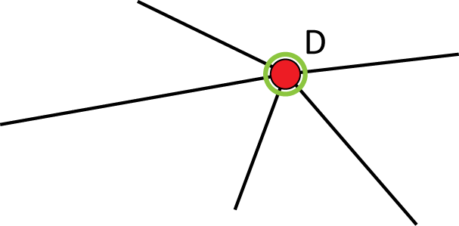
What does degree have to do with Euler circuits?
What if we had started at D?

Slide 35
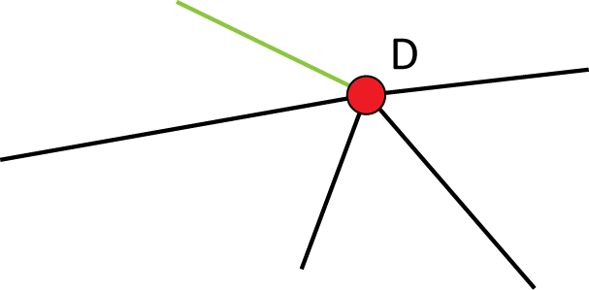
What does degree have to do with Euler circuits?
First, we need to leave D…

Slide 36
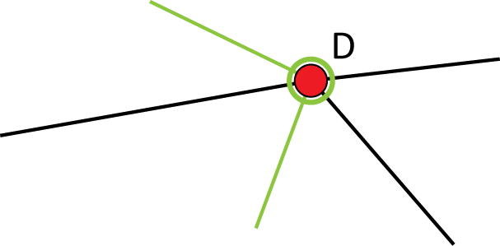
What does degree have to do with Euler circuits?
… then sometime later, we have to come back to D…

Slide 37
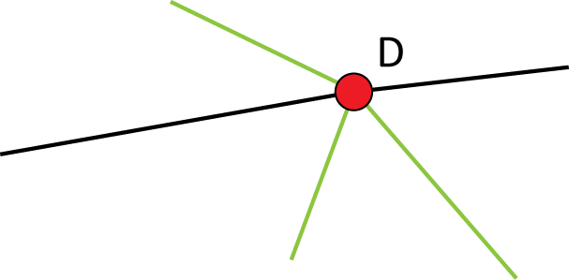
What does degree have to do with Euler circuits?
… and then leave again …

Slide 38
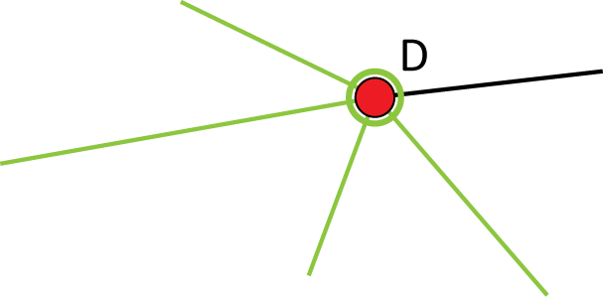
What does degree have to do with Euler circuits?
… and then come back again …

Slide 39
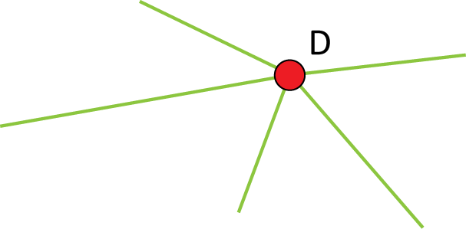
What does degree have to do with Euler circuits?
… and then leave again.
But D was our starting point, and we have run out of edges to use to come back to D!

Slide 40
No Euler Circuits With Odd Degrees
If a graph has any vertex with an odd degree, then the graph does not have an Euler circuit
The reverse is true as well

Slide 41
Euler’s Theorem
If a graph has all even degrees, then it has an Euler circuit. If a graph has any vertices with odd degree, then it does not have an Euler circuit.

Slide 42
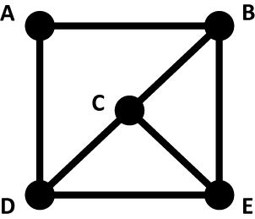
Practice With Euler’s Theorem
Does this graph have an Euler circuit? If not, explain why. If so, then find one.

Slide 43
Practice With Euler’s Theorem
Does this graph have an Euler circuit? If not, explain why. If so, then find one.
Answer: No, since vertex C has an odd degree.

Slide 44
Practice With Euler’s Theorem
Does this graph have an Euler circuit? If not, explain why. If so, then find one.
Notice that D and E also have odd degree, but we only need one odd-degree vertex for Euler’s Theorem

Slide 45
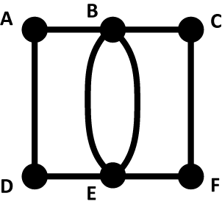
Practice With Euler’s Theorem
Does this graph have an Euler circuit? If not, explain why. If so, then find one.

Slide 46
Practice With Euler’s Theorem
Does this graph have an Euler circuit? If not, explain why. If so, then find one.
Answer: All of the vertices have even degree, so there must be an Euler circuit…

Slide 47
Practice With Euler’s Theorem
Does this graph have an Euler circuit? If not, explain why. If so, then find one.
Answer (continued): With some trial and error, we can find an Euler circuit: A,B,C,F,E,B,E,D,A

Slide 48
Practice With Euler’s Theorem
Does this graph have an Euler circuit? If not, explain why. If so, then find one.
Note there are many different circuits we could have used

